Slide 1
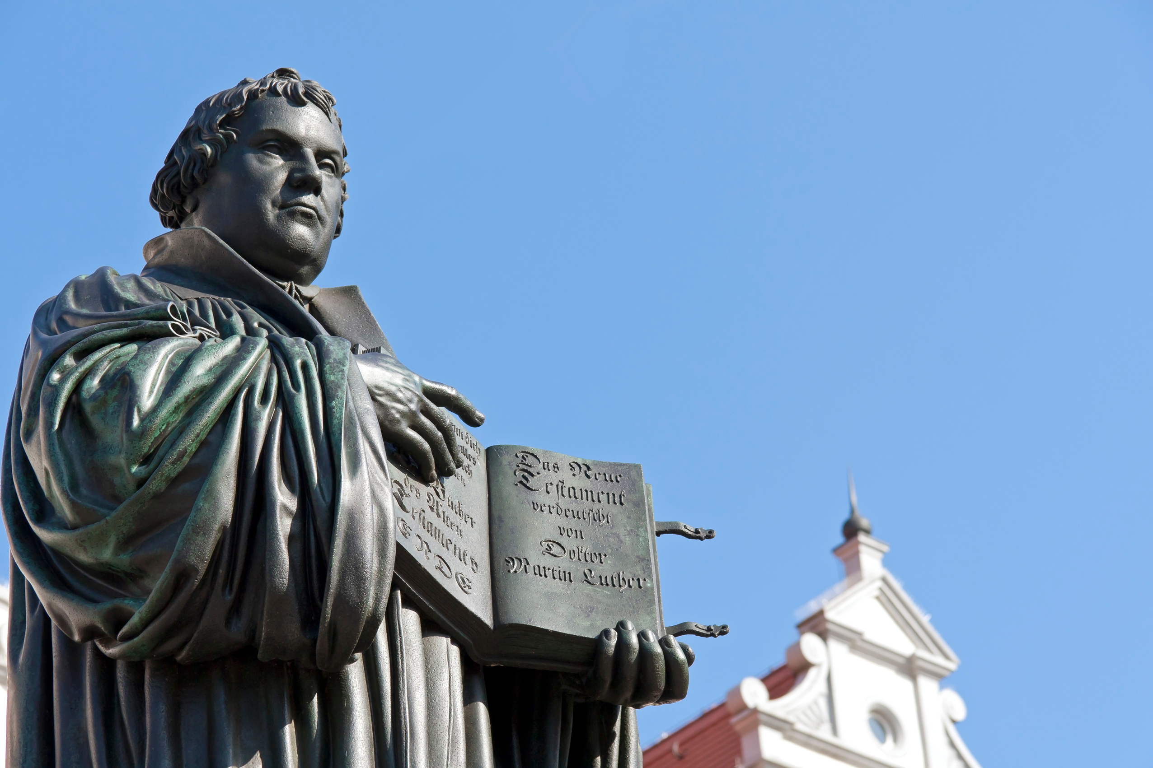



1517 to 1650
Chapter 10
THE REFORMATION
the reformation
Strand Three: The History of Europe and the Wider World
@MsDoorley

Slide 2

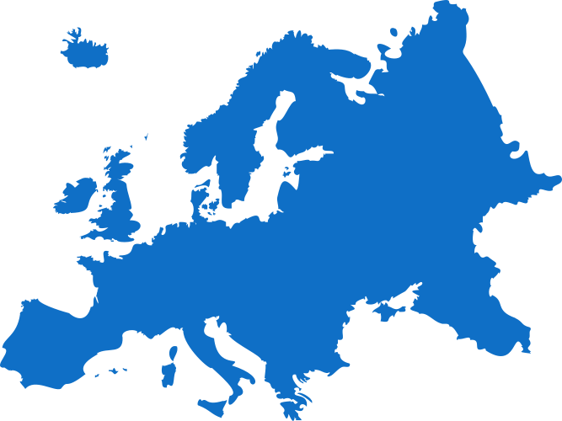




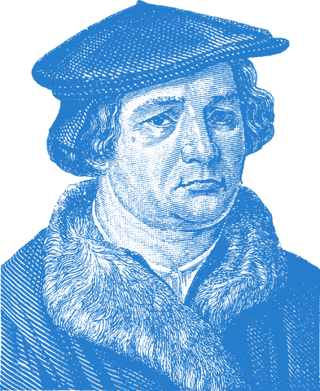
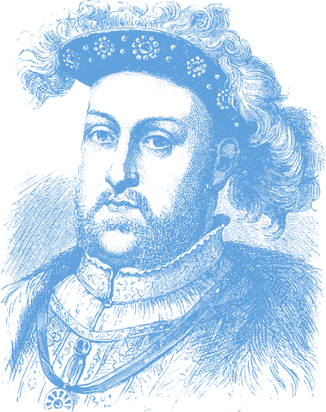
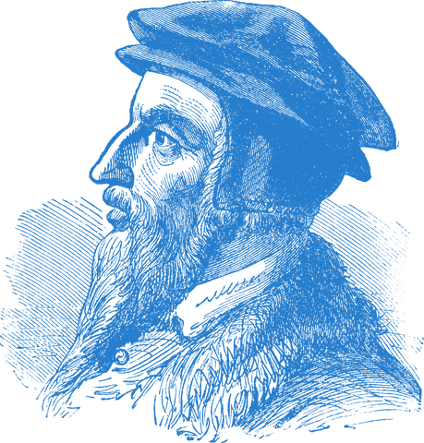




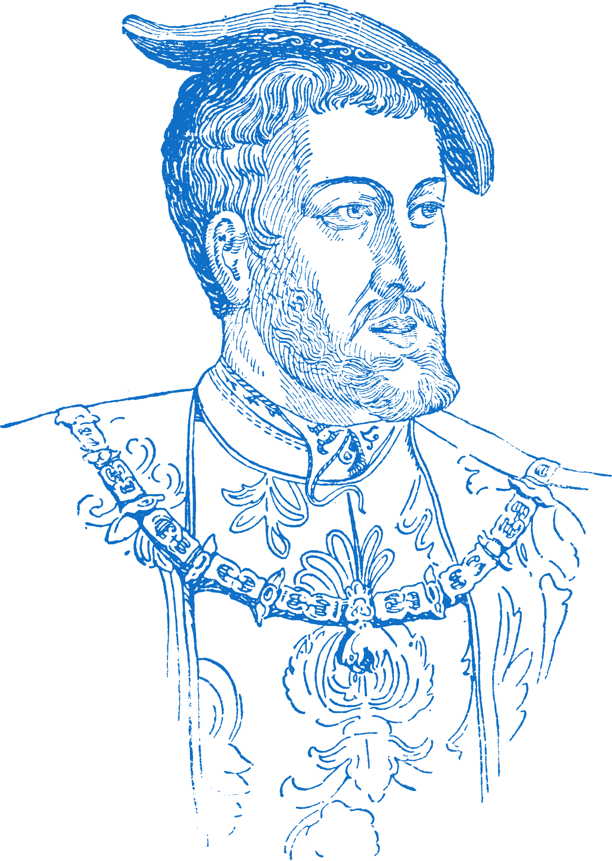
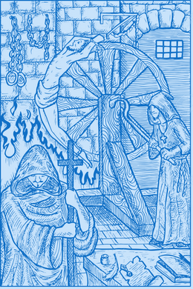










Chapter 10
THE REFORMATION
Henry VIII established the Church of England as he separates from the Catholic Church.
John Calvin establishes Presbyterianism in Geneva, Switzerland.
Martin Luther burns the Papal Bull
1517
1520
1521
1534
1540
1541
1545
Strand Three: The History of Europe and the Wider World
Chapter Ten: The Reformation
Martin Luther nails his 95 theses on the door of the Wittenberg Church, beginning the Protestant Reformation.
Holy Roman Emperor Charles V calls the Diet of Worms, which outlaws Luther
The Counter Reformation begins
The Inquisition begins two years later.
The Council of Trent results in self reforming the Catholic Church and its flaws.
@MsDoorley

Slide 3


Learning Outcomes
3.8 CONSIDER the historical importance of religion, with particular reference to the Reformation and the actions of one Reformer
1.2 CONSIDER contentious or controversial issues in history from more than one perspective and discuss the historical roots of a contentious or controversial issue or theme in the contemporary world.
1.7 DEVELOP historical judgements based on evidence about personalities, issues and events in the past showing awareness of historical significance.
Strand Three: The History of Europe and the Wider World
Chapter Ten: The Reformation
@MsDoorley

Slide 4
Introduction
The Reformation was a period in history when people began to question the teachings of the Catholic Church and to challenge the authority of the Pope.
It began in Germany in 1517 as a protest against abuses of power in the Catholic Church and was originally about reforming the Church.
The supporters of this desire for reform were called Protestants.
In this chapter, we will learn about the causes of the Reformation, its central figures, Martin Luther and the responses of the Catholic Church.
Strand Three: The History of Europe and the Wider World
Chapter Ten: The Reformation
@MsDoorley

Slide 5
1517 to 1650
Chapter 10
10.1: THE CAUSES OF THE REFORMATION
10.1: the causes of the reformation
Strand Three: The History of Europe and the Wider World
@MsDoorley

Slide 6
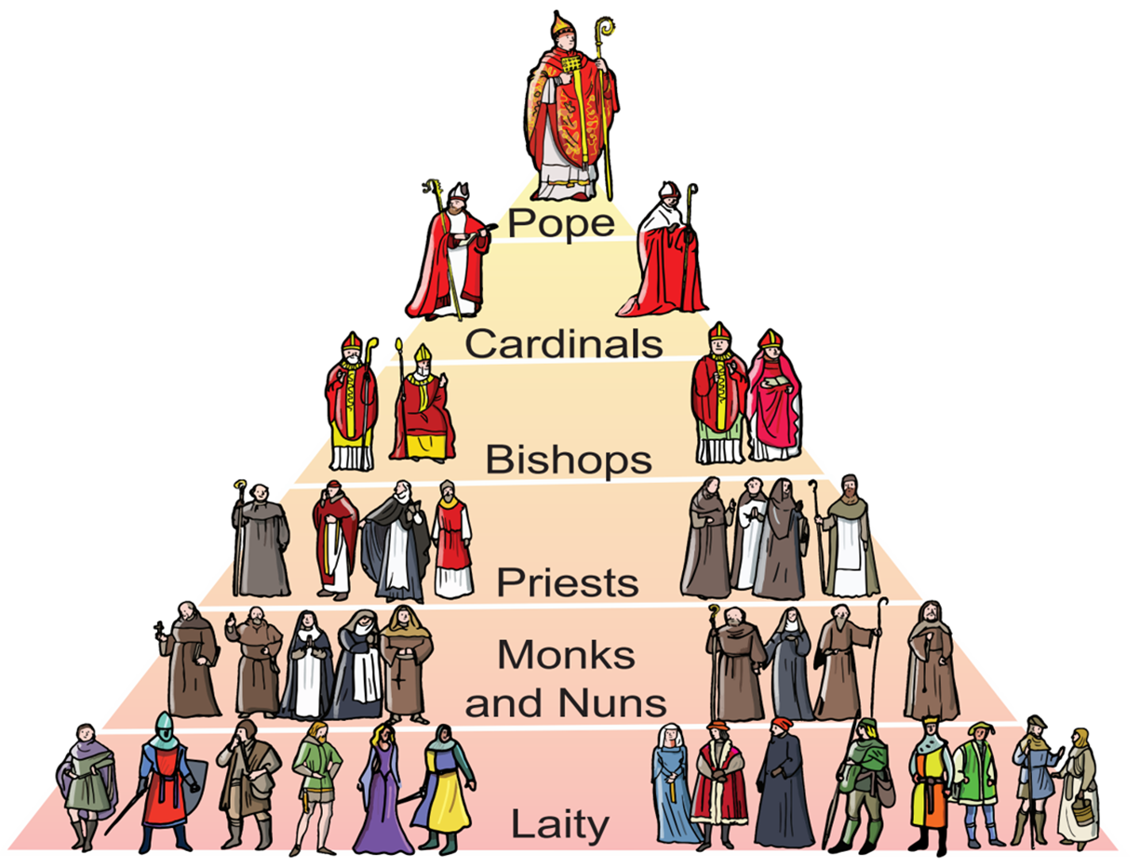
The Catholic Church in the early 1500s
We saw in Chapter 6 how important religion was in people’s lives in the Middle Ages and the power of the Catholic Church. It was incredibly wealthy, had priests in every community and the Pope had power over the kings of Europe. The Catholic Church held so much power that if anyone dared to go against them, they were labelled a heretic and punished – usually by being burnt at the stake (we saw that Galileo was placed under house arrest instead).
Strand Three: The History of Europe and the Wider World
Chapter Ten: The Reformation
Diagram taken from Artefact, 2nd Edition by Eimear Jenkinson and Gregg O'Neill (educate.ie)
@MsDoorley

Slide 7
The Influence of the Renaissance
The Church had helped to create the Renaissance by funding artists. However, this had an unintended consequence which encouraged people to question old beliefs.
  As more people learned to read, more people could read the Bible for themselves – rather than accept everything told to them by priests and bishops. The people’s interpretations of the meaning of the Bible often differed from those of the Church.
  The invention of the Printing Press meant that the ideas of Reformers (like Martin Luther) spread quickly around Europe and this encouraged people to support them and challenge the Church themselves.
Strand Three: The History of Europe and the Wider World
Chapter Ten: The Reformation
@MsDoorley

Slide 8
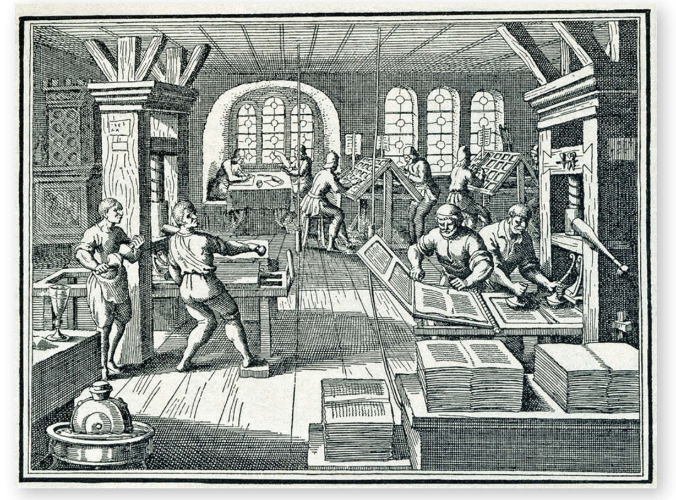
Strand Three: The History of Europe and the Wider World
Chapter Ten: The Reformation
Diagram taken from Artefact, 2nd Edition by Eimear Jenkinson and Gregg O'Neill (educate.ie)
@MsDoorley

Slide 9
The Wealth of the Church
The Church was the wealthiest organisation in Europe.
  Bishops and monasteries were huge land owners. For example; it is estimated that one-third (1/3) of all the land in Germany belonged to the Church. This wealth was resented by kings and nobles.
  Everyone had to pay their tithe to their local bishop every year. This was greatly resented by ordinary people, especially when they saw these bishops and cardinals living extravagant lifestyles.
Strand Three: The History of Europe and the Wider World
Chapter Ten: The Reformation
@MsDoorley

Slide 10
Abuses within the Church
There were many abuses of power within the Church which made people believe priests and bishops had little interest in serving God. These abuses included:
  Simony – the buying or selling of positions within the Church.
  Nepotism – the appointing of relatives to Church jobs regardless of merit.
  Pluralism – holding more than one Church job at the same time.
  Absenteeism – a priest or bishop being absent from their parish or diocese for long periods of time.
  Sale of indulgences – the sale of special prayers that were to said to reduce the time a soul spent in purgatory (waiting place between heaven and hell)
  Misbehaviour of priests, bishops and popes – many priests and bishops did not live very Christian lives with many of them openly having mistresses and fathering children while Popes such as Julius II and Alexander VI often appeared to be more concerned about persuing their own power and expanding the land they ruled.
Strand Three: The History of Europe and the Wider World
Chapter Ten: The Reformation
@MsDoorley

Slide 11
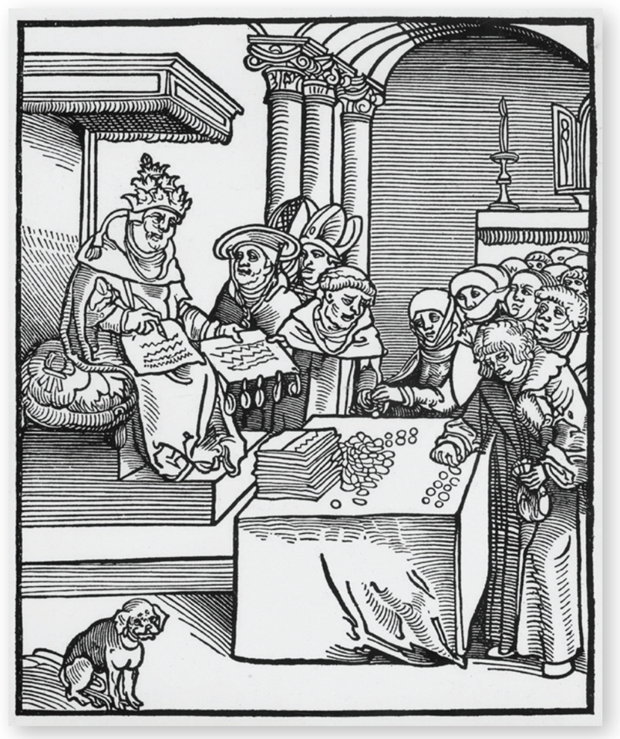
The power of Kings
Kings around Europe had spent most of the Middle Ages bringing their nobles and lords under control as well as establishing their rule throughout their kingdoms. The Church, however, remained outside their authority as it was controlled from Rome, not locally. The European Kings hated this and looked for ways to weaken the Church’s power so that they could gain control over its wealth.
Strand Three: The History of Europe and the Wider World
Chapter Ten: The Reformation
Diagram taken from Artefact, 2nd Edition by Eimear Jenkinson and Gregg O'Neill (educate.ie)
@MsDoorley

Slide 12
Checkpoint (pg. 82, Artefact, 2nd Edition)
  How did the Renaissance influence the start of the Reformation?
  Why was the printing press an important factor in the Reformation?
  Explain the following terms: simony; nepotism; pluralism; absenteeism.
  What was an indulgence and why was their sale so controversial?
  Why did the (a) wealth and (b) power of the Catholic Church cause resentment?
  Which of the causes of the Reformation do you think was the most important? Explain your answer.
Strand Three: The History of Europe and the Wider World
Chapter Ten: The Reformation
@MsDoorley

Slide 13
Checkpoint (pg. 82, Artefact, 2nd Edition)
  The Renaissance encouraged people to question old beliefs. An increase in literacy also helped people to gather information independently.
  The ideas of the Reformers spread quickly around Europe in printed books and pamphlets.
  Simony: the buying or selling of positions within the Church; nepotism: the appointing of relatives to Church jobs regardless of merit; pluralism: holding more than one Church position at the same time; absenteeism: priests or bishops being absent from their parish or diocese for long periods of time.
  An indulgence was a special prayer to reduce the amount of time a soul spent in purgatory; the idea that forgiveness of sins could be bought for money outraged many.
    The Church was wealthier than some kings and ordinary people paid tithes to it.
    The Church was beyond the power of kings, who wanted to have full control over the countries they ruled.
Strand Three: The History of Europe and the Wider World
Chapter Ten: The Reformation
@MsDoorley

Slide 14
1517 to 1650
Chapter 10
10.2: MARTIN LUTHER, 1483-1546
10.2: martin luther, 1483-1546
Strand Three: The History of Europe and the Wider World
@MsDoorley

Slide 15
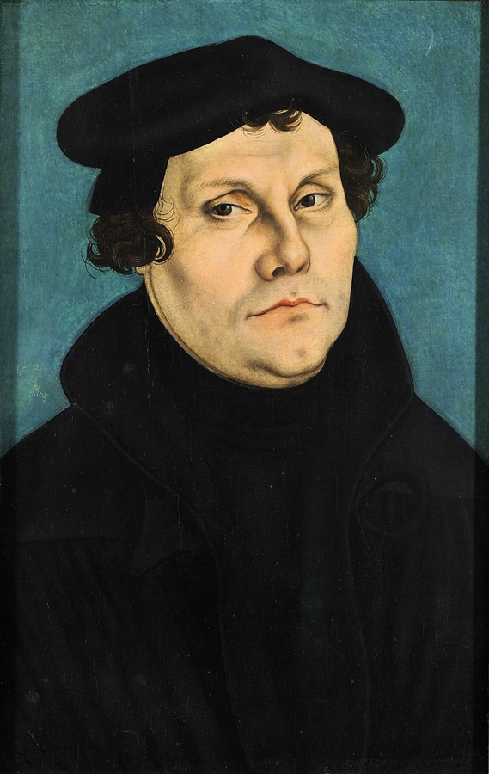
Early Life
Martin Luther was the man who started the Reformation. He was born to a wealthy family in Saxony, Germany (then part of the Holy Roman Empire) in 1483. After studying law, he decided to become an Augustinian monk. He studied theology and became Professor of Theology at the University of Wittenberg.
Strand Three: The History of Europe and the Wider World
Chapter Ten: The Reformation
Diagram taken from Artefact, 2nd Edition by Eimear Jenkinson and Gregg O'Neill (educate.ie)
@MsDoorley

Slide 16
Justification by Faith Alone
Luther spent most of his time studying the bible in great detail to ensure he was doing all he could to go to heaven. The Catholic Church taught that to get to heaven you had to have faith in God and preform good works (prayer, fasting, pilgrimages, indulgences, giving to charity). However, Luther found no mention in the bible of good works and came to believe that only God could forgive sins and only faith in God would save his soul. He called his teaching ‘justification by faith alone’ – only faith in God could get a person into heaven.
Strand Three: The History of Europe and the Wider World
Chapter Ten: The Reformation
@MsDoorley

Slide 17
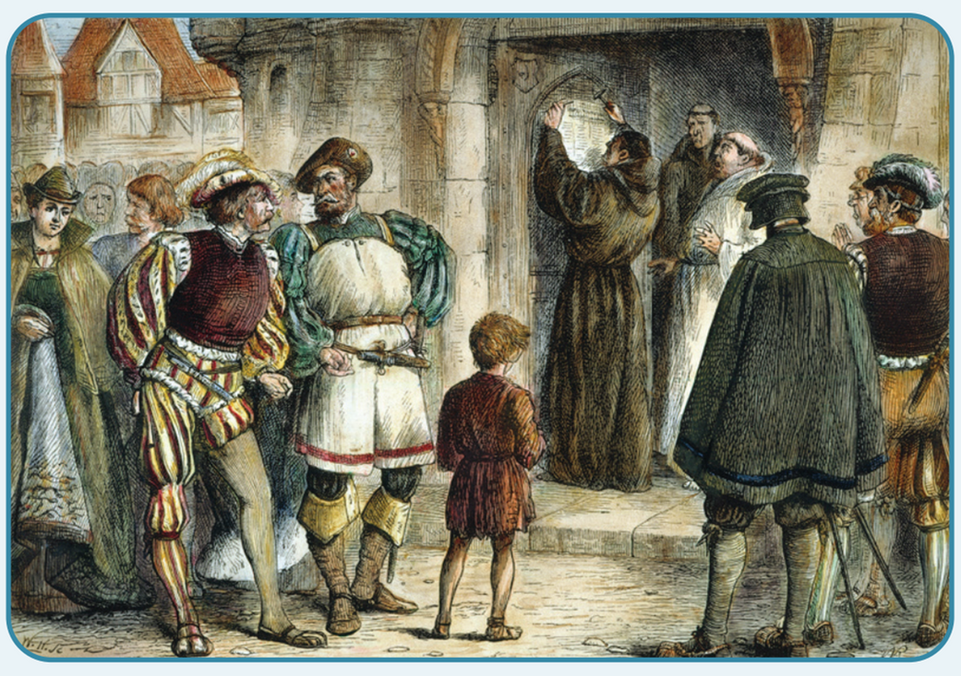
The Sale of Indulgences
In 1517, John Tetzel arrived in Wittenberg selling indulgences to the local people. Half of the money was for the rebuilding of St Peter’s Basilica while the other half went to the Archbishop of Mainz. Luther was furious; especially as Tetzel was telling people that they were guaranteed a place in heaven if they bought an indulgence from him. Luther wrote to the archbishop in protest but he was ignored.
Strand Three: The History of Europe and the Wider World
Chapter Ten: The Reformation
Diagram taken from Artefact, 2nd Edition by Eimear Jenkinson and Gregg O'Neill (educate.ie)
@MsDoorley

Slide 18
The Ninety-Five Theses
Luther wrote out ninety-five theses (arguments) in Latin. He is said to have nailed them to the door of his church in Wittenberg – but there are some doubts this actually happened. He initial aim seems to have been to encourage debate amongst scholars at the university.
However, the Ninety-Five Theses were quickly translated into German. Thanks to the Printing Press, they spread all over Germany and quickly turned into a full-scale public attack on the authority of the Pope.
Some of the main ideas within Luther’s ninety-five theses included:
  The Pope had no power to forgive sins.
  Indulgences do not save people from punishment for their sins.
  As one of the richest men in Europe, the Pope should rebuild St Peter’s himself instead of taking money from the poor.
Strand Three: The History of Europe and the Wider World
Chapter Ten: The Reformation
@MsDoorley

Slide 19
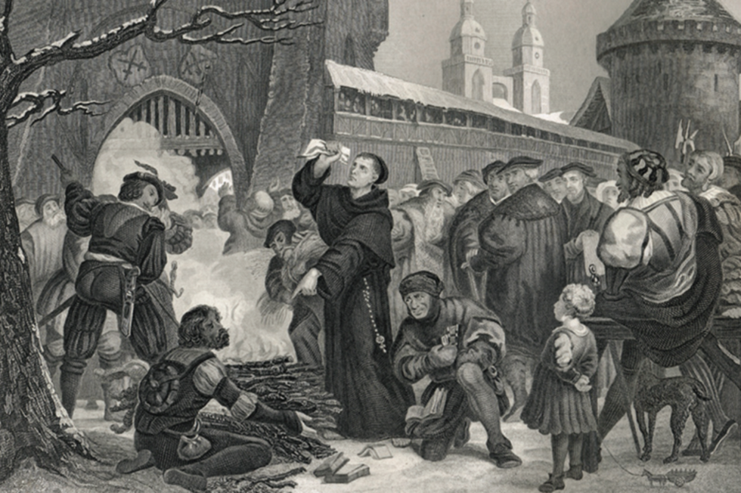
The Response of the Catholic Church
At first, Pope Leo X did not consider Luther to be a real problem. It was only in 1519 – two years later – after the theses had spread that he sent the theologian John Eck to debate Luther in public. This time, Luther went further than before and claimed that the Pope had no more power to interpret the Bible than anyone else.
Leo ordered Luther to recant (take back what he said) but he refused. Next, Leo sent a papal bull (a formal letter and command by the Pope) threatening Luther with excommunication (to be thrown out of the Catholic Church and unable to receive the sacraments). Luther responded by publicly burning it and was excommunicated in 1521.
Strand Three: The History of Europe and the Wider World
Chapter Ten: The Reformation
Diagram taken from Artefact, 2nd Edition by Eimear Jenkinson and Gregg O'Neill (educate.ie)
@MsDoorley

Slide 20
The Diet of Worms
Luther continued to write pamphlets and give sermons rejecting the power of the Pope. The Holy Roman Emperor, Charles V, (ruler of Germany) called a meeting (Diet) of German princes at Worms in 1521 about Luther. Luther was given safe passage there to discuss his beliefs but he refused to change his mind.
After the Diet, Charles V issued the Edict of Worms, making Luther an outlaw. Luther’s supporters protested against this and afterwards became known as ‘Protestants’. Luther was to be arrested and punished for heresy (knowingly holding beliefs that went against the official teachings of the Church). Fearing for Luther’s life, Prince Frederick of Saxony arranged a fake kidnapping and hid Luther in Wartburg Castle for a year. There Luther translated the Bible into German so that everyone could read it for themselves.
Strand Three: The History of Europe and the Wider World
Chapter Ten: The Reformation
@MsDoorley

Slide 21
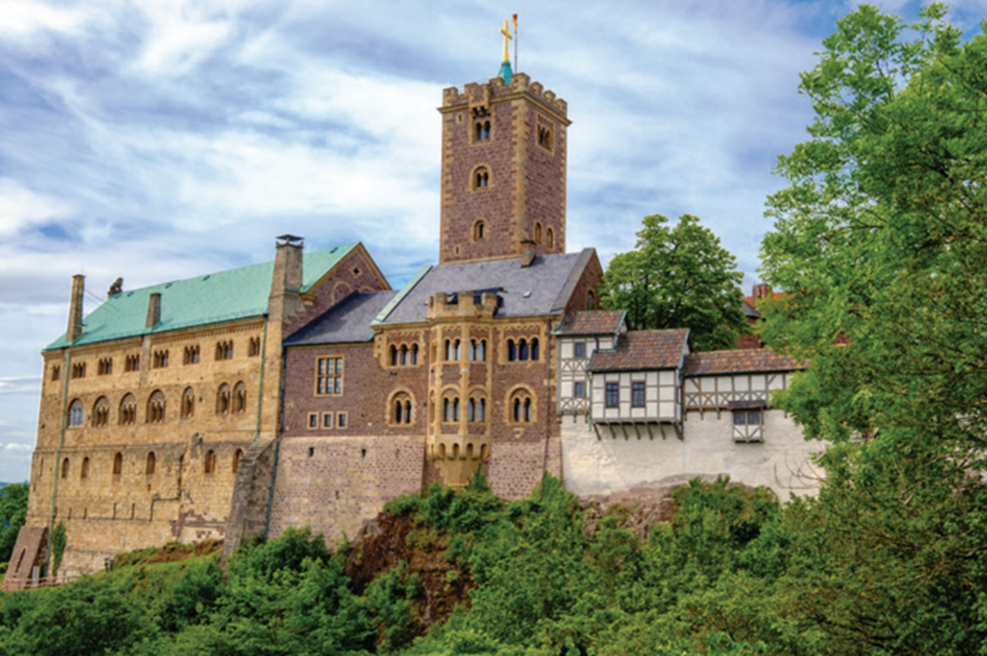
Strand Three: The History of Europe and the Wider World
Chapter Ten: The Reformation
Diagram taken from Artefact, 2nd Edition by Eimear Jenkinson and Gregg O'Neill (educate.ie)
@MsDoorley

Slide 22
Luther’s Beliefs
  The Bible – not the Pope or the Church – is the only source of guidance for Christians. There is no need for bishops or a Church hierarchy (structure of power).
  Therefore, each prince or king should control the Church in the area under their rule.
  Mass and the Bible should be in the vernacular (the language of the people) instead of Latin so that everyone can understand them.
  ‘Justification by Faith Alone.’
  The clergy should be allowed to marry.
  Luther had two sacraments (baptism and communion) rather than seven of Catholicism (baptism, confession, communion, confirmation, marriage, the last rites and ordination).
  Consubstantiation rather than transubstantiation:
    Consubstantiation is when the bread and wine is a symbol of the body and blood of Jesus.
    Transubstantiation is when the bread and wine are transformed into the body and blood of Jesus.
Strand Three: The History of Europe and the Wider World
Chapter Ten: The Reformation
@MsDoorley

Slide 23
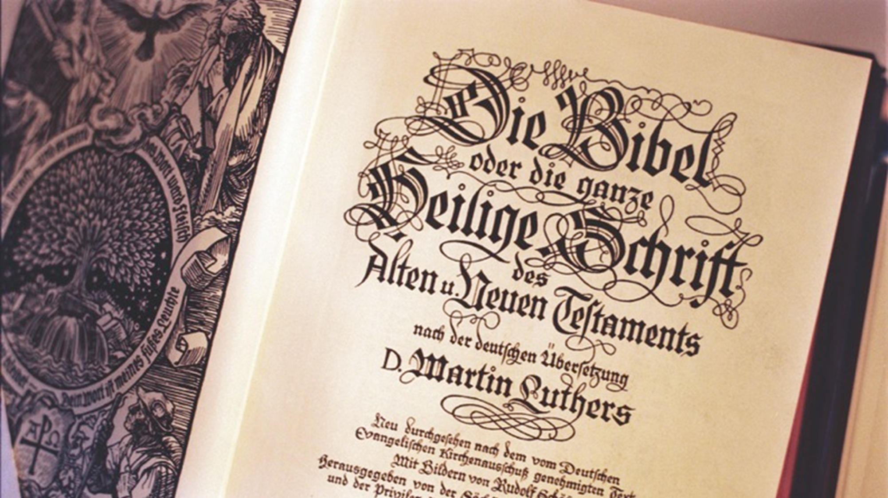
Strand Three: The History of Europe and the Wider World
Chapter Ten: The Reformation
Diagram taken from Artefact, 2nd Edition by Eimear Jenkinson and Gregg O'Neill (educate.ie)
@MsDoorley

Slide 24
Later Life and Impact
Luther married an ex-nun, Catherine von Bora, and they had six children. He continued to write and preach until his death in 1546. His beliefs spread rapidly and had huge consequences for Germany and Europe.
  Many princes rejected Charles V’s decision at Worms and wanted to follow Luther’s teachings in their states. War broke out shortly after his death and raged until the Peace of Augsburg in 1555 when it was agreed that each ruler would choose the religion in his state.
  The Reformation spread throughout Europe, leading to the formation of many other ‘Protestant religions’.
  Eventually, the Catholic Church was forced to address many of the problems Luther raised, by bringing in reforms; this was called the Counter-Reformation.
Strand Three: The History of Europe and the Wider World
Chapter Ten: The Reformation
@MsDoorley

Slide 25
Checkpoint (pg. 82, Artefact, 2nd Edition)
  Explain the following terms: justification by faith alone; excommunication; heresy; vernacular.
  How did Martin Luther protest against the sale of indulgences?
  How did Pope Leo X respond to Luther’s actions?
  What happened at the Diet of Worms?
  What happened to Luther after the Diet?
  Explain Luther’s beliefs on; (a) the language of Mass and the Bible; (b) the sacraments; (c) what happens at communion.
  Name one consequence of Luther’s actions.
Strand Three: The History of Europe and the Wider World
Chapter Ten: The Reformation
@MsDoorley

Slide 26
1517 to 1650
Chapter 10
10.3: THE SPREAD OF THE REFORMATION
10.3: the spread of the reformation
Strand Three: The History of Europe and the Wider World
@MsDoorley

Slide 27
Other Major Reformation Events
The Reformation spread quickly throughout Europe. Luther’s teachings led to many others to question the teachings of the Catholic Church. Some came to the main conclusions as Luther while others would take a very different approach.
  1531: Ulrich Zwingli launched the Reformation in Switzerland.
  1534: Henry VIII established the Church of England as separate from the Catholic Church with himself as head.
  1541: John Calvin was invited to Geneva, Switzerland to set up his version of Protestantism; Presbyterianism. Presbyterianism was very different to both Lutheranism and Catholicism. Calvin believed in predestination – God had already decided who was going to heaven before people were born. This form of Christianity had very strict laws – no statues, gambling, fancy clothing and anything else that he thought would lead people into sin.
  1571: The Netherlands become Protestant.
  1572: John Knox introduced Presbyterianism to Scotland.
Within a century of Luther’s teachings, the Protestant challenge had spread across Europe. The continent divided along religious lines. Most of the northern countries became Protestant while the south remained mostly Catholic the closer they were to Rome. The Catholic Church was forced to launch the Counter-Reformation to slow or halt the growth of Protestantism.
Strand Three: The History of Europe and the Wider World
Chapter Ten: The Reformation
@MsDoorley

Slide 28
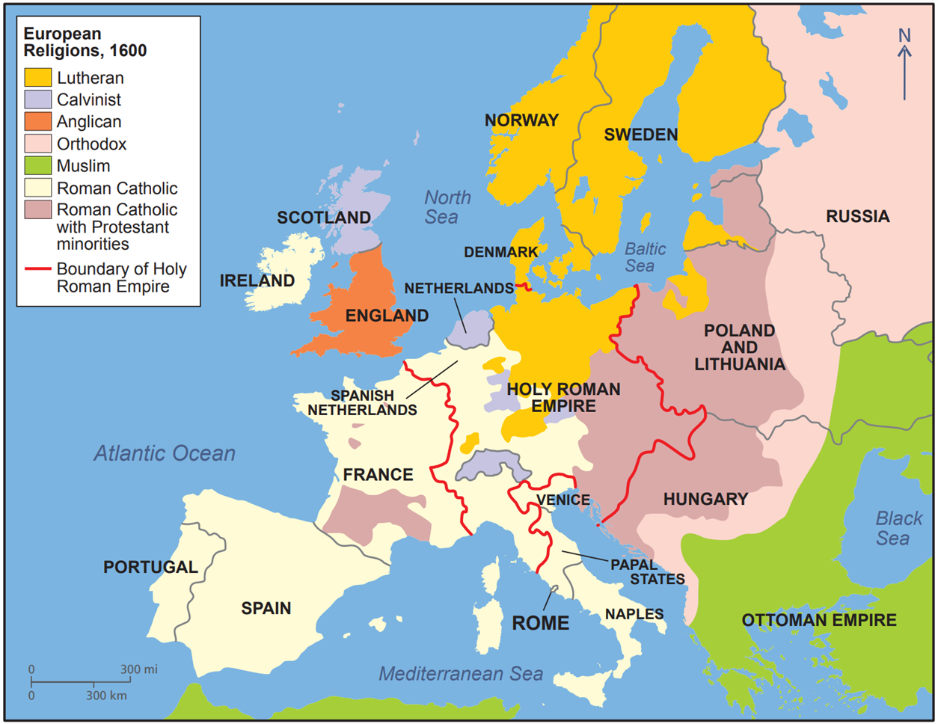
Strand Three: The History of Europe and the Wider World
Chapter Ten: The Reformation
Diagram taken from Artefact, 2nd Edition by Eimear Jenkinson and Gregg O'Neill (educate.ie)
@MsDoorley

Slide 29
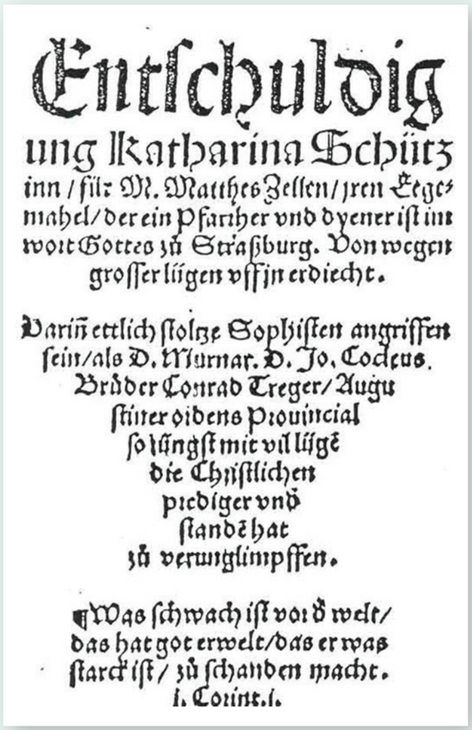
Katharina Zell, 1497-1562
Katharina Schütz Zell was one of the first women in Europe to marry a former priest in the Reformation. She was born in Strasbourg and was given an excellent education for her time: she could read and write in German and Latin. Her interest in the writings of the Reformers when she met and married Matthew Zell, a former Catholic Priest, in 1523. She wrote a scriptural defence of clerical marriage that brought the issue into the public arena and removed much of the stigma surrounding it. Her arguments were cited by Luther and other Reformers. She wrote many pamphlets, often on women and children's roles in the Reformation. The Zells were leading figures in the civic and church life in Strasbourg. Katharina took the lead in feeding and housing the poor, running women's ministries and organising relief for Protestant refugees, in one case for more than 3,000 people over six months. She also urged peace between Luther and Zwingli following their dispute over the Eucharist and the Mass. Despite her significance, no portraits of Katharina Schütz Zell survive. At this time, non-noble women were rarely considered important enough to have their portraits painted.
Strand Three: The History of Europe and the Wider World
Chapter Eight: The Renaissance
Diagram taken from Artefact, 2nd Edition by Eimear Jenkinson and Gregg O'Neill (educate.ie)
@MsDoorley

Slide 30
Checkpoint (pg. 141, Artefact, 2nd Edition)
  Name four European countries that became Protestant during the Reformation.
  Explain the terms Presbyterianism and predestination.
  Where did John Calvin set up his church?
  Why do you think that southern Europe remained Catholic while northern Europe became Protestant?
Strand Three: The History of Europe and the Wider World
Chapter Ten: The Reformation
@MsDoorley

Slide 31
Checkpoint (pg. 141, Artefact, 2nd Edition)
1. Any four of: Scotland, England, Netherlands, Denmark, Norway, Sweden, Switzerland, parts of France, Germany.
2. Presbyterianism: religion set up by John Calvin in Geneva, Switzerland. Predestination: the belief that God had already decided before a person was born whether they would go to heaven.
3. Geneva, Switzerland.
4. Southern Europe was closer to the power centre of the Catholic Church (Rome) and therefore it was easier for the Church to keep control over those areas.
Strand Three: The History of Europe and the Wider World
Chapter Ten: The Reformation
@MsDoorley

Slide 32
1517 to 1650
Chapter 10
10.4: THE COUNTER REFORMATION
10.4: the counter reformation
Strand Three: The History of Europe and the Wider World
@MsDoorley

Slide 33
Courts of Inquisition
The Church set up the Courts of Inquisition to arrest, try and punish anyone who they thought was a threat to the Church’s teachings. Imprisonment and torture were used to get people accused to heresy to recant their views. People found guilty of the most serious offences could be burned at the stake (the auto-da-fé). These burnings were always done in public to remind people of the danger they faced if they challenged the Church.
Other punishments included:
  Imprisonment
  Fines
  Confiscation of property
  Expulsion
  Wearing a yellow cloak (sanbenito)
The Inquisition was quite successful in limiting the spread of the Reformation, especially in Italy and Spain.
Strand One: The Nature of History
Chapter Ten: The Reformation
@MsDoorley

Slide 34
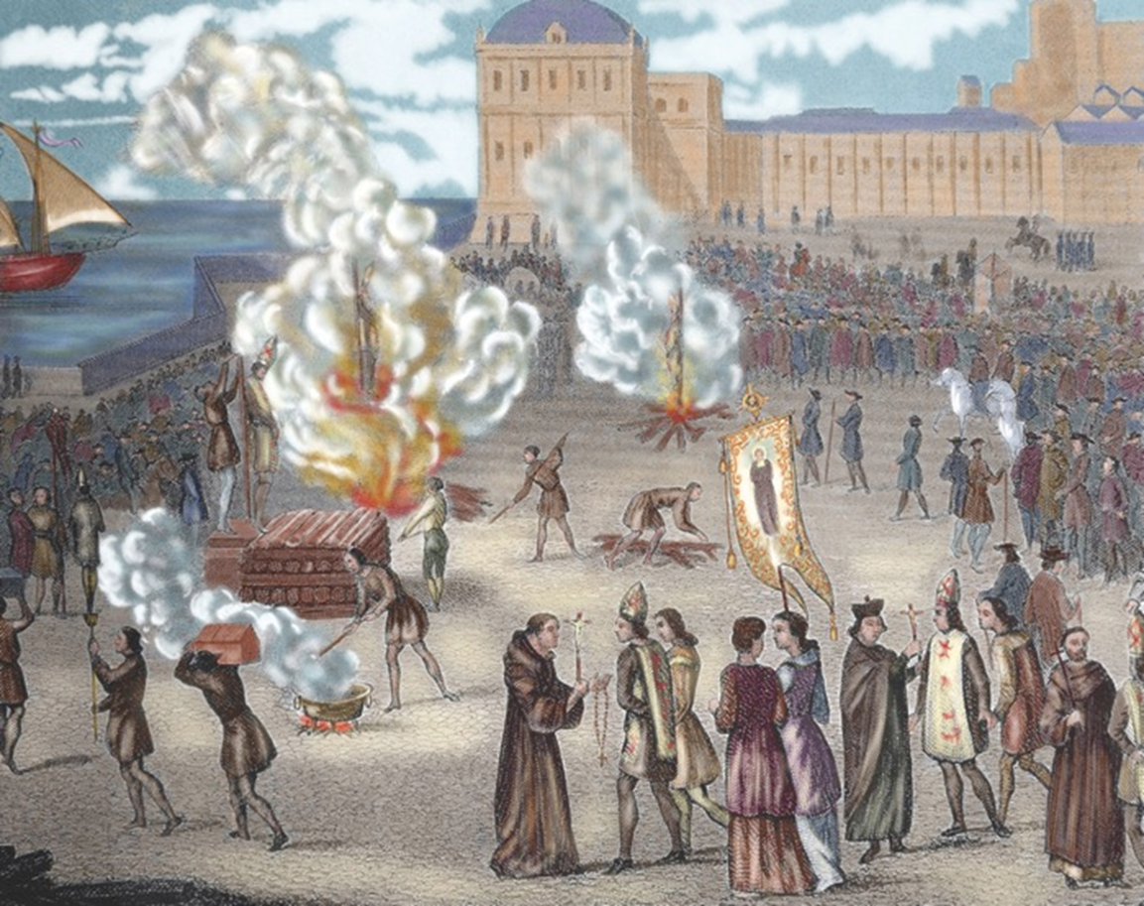
Strand Three: The History of Europe and the Wider World
Chapter Ten: The Reformation
Diagram taken from Artefact, 2nd Edition by Eimear Jenkinson and Gregg O'Neill (educate.ie)
@MsDoorley

Slide 35
New Religious Order
The Church saw that it needed to reconnect with the faithful and so several new religious orders were founded to do this. For example, the Urusline nuns and Capuchin monks worked in communities helping people and preaching the gospel. These orders set up schools and hospitals around Europe to help the poor.
The most important of the new religious orders was the Society of Jesus – the Jesuits. They were founded by a former Spanish soldier, Ignatius Loyola, in 1534. His order was like an army, with a general leading and priest ‘soldiers’ who were expected to follow orders without question. They quickly gained a reputation as being highly educated and very successful in their two main tasks:
  Travelling the world as missionaries to convert people in South America and Asia to Catholicism.
  Setting up schools to educate the sons of nobility or wealthy families so that they would have power and social influence when they grew up.
Strand Three: The History of Europe and the Wider World
Chapter Ten: The Reformation
@MsDoorley

Slide 36
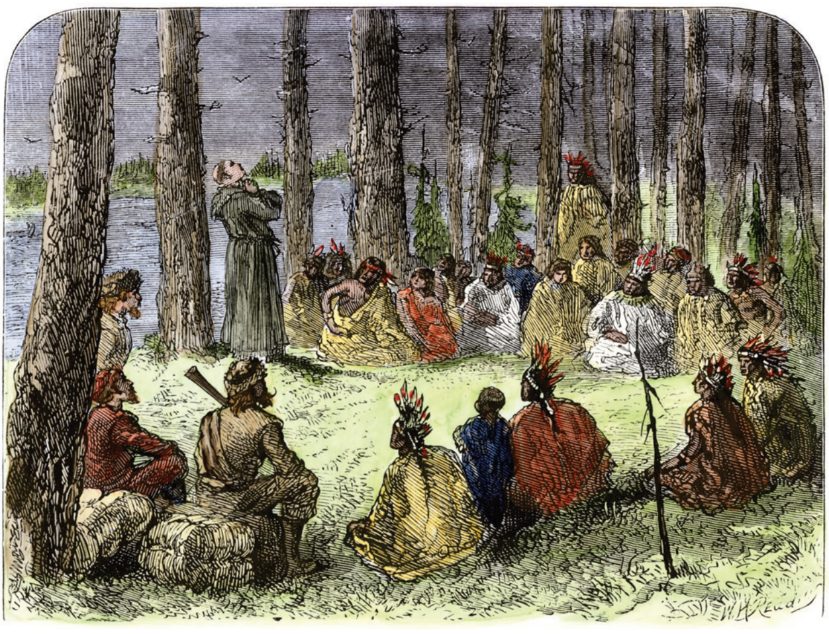
Strand Three: The History of Europe and the Wider World
Chapter Ten: The Reformation
Diagram taken from Artefact, 2nd Edition by Eimear Jenkinson and Gregg O'Neill (educate.ie)
@MsDoorley

Slide 37
The Council of Trent
The Council of Trent was the Church’s response to the attack on its teachings by the Reformers. Senior bishops and cardinals from various countries met between 1545 and 1563 in Trento, Italy. The Council attempted to deal with the Church’s existing problems and to impose discipline on its clergy by:
  Simony, pluralism, nepotism, absenteeism and the sale of indulgences were banned.
  Seminaries were set up in every diocese to train priests.
  Priests were to be celibate and could not marry.
  Strict rules and punishments were introduced for priests who broke these rules.
  It published a list of books that Catholics were forbidden to read (The Index of Prohibited Books).
It also clarified Catholic teachings and defended them against Reformer arguments:
  Faith and good workswere required to get into heaven.
  There were seven sacraments.
  Mass and the Bible must be in Latin (this would change in 1963).
  The rulebook for Catholicism, the Catechism, was published – with clear, simple answers to questions about their faith and ensure consistency.
The Counter-Reformation was largely successful in preventing the further spread of Protestantism – but were unable to reverse it in any country that it had taken hold.
Strand Three: The History of Europe and the Wider World
Chapter Ten: The Reformation
@MsDoorley

Slide 38
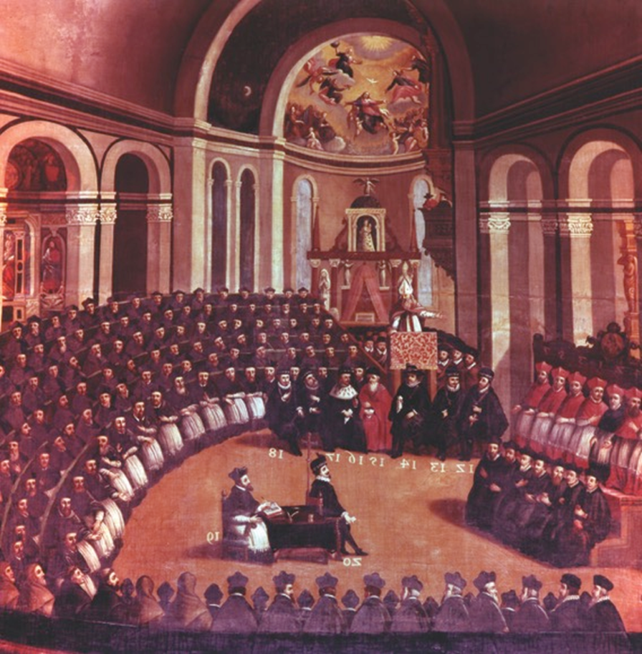
Strand Three: The History of Europe and the Wider World
Chapter Ten: The Reformation
Diagram taken from Artefact, 2nd Edition by Eimear Jenkinson and Gregg O'Neill (educate.ie)
@MsDoorley

Slide 39
Checkpoint (pg. 143, Artefact, 2nd Edition)
  What were the Courts of Inquisition?
  How was the Inquisition used against the Reformation?
  How did the Jesuits try to combat the Reformation?
  What was the Council of Trent?
  How did it respond to problems and abuses in the Church?
  What was the Catechism and why was it important?
Strand Three: The History of Europe and the Wider World
Chapter Ten: The Reformation
@MsDoorley

Slide 40
Checkpoint (pg. 143, Artefact, 2nd Edition)
1. Courts of Inquisition: a Church court set up during the Counter-Reformation to arrest, try and punish anyone thought to be a threat to Church teaching.
2. The Inquisition used imprisonment, torture, burning at the stake, fines, confiscation of property to limit the spread of the Reformation.
3. They converted the peoples of South America to Catholicism and introduced Catholicism to Asia; they set up schools for the sons of the nobility and wealthy families to ensure they remained Catholic.
4. A regular meeting of bishops between 1545 and 1563; it was the Church’s response to the Protestant attack on its teachings.
5. It banned the sale of indulgences, simony, nepotism, pluralism and absenteeism; seminaries were set up to train priests; priests were to be celebate and could not marry; strict rules and punishments were introduced for priests who broke these rules; it published a list of books that Catholics were forbidden to read.
6. It was a single ‘rule book’ for Catholicism, designed to provide people with clear, simple answers to questions about their faith, and also to ensure there was consistency in how Catholicism was taught across Europe.
Strand Three: The History of Europe and the Wider World
Chapter Ten: The Reformation
@MsDoorley

Slide 41
1517 to 1650
Chapter 10
10.5: THE RESULTS OF THE REFORMATION
10.5: the results of the reformation
Strand Three: The History of Europe and the Wider World
@MsDoorley

Slide 42
Division and persecution
By 1650, Europe had divided into a largely Protestant north and a Catholic south. There were minority groups in most countries and these people faced persecution. As the Inquisition arrested, tried and killed many Protestants in Catholic countries, Protestants did the same to Catholics in their countries. Many countries introduced laws which banned members of other faiths holding office, owning property or attending their own religious services – as what would happen in Ireland under British rule.
Strand Three: The History of Europe and the Wider World
Chapter Ten: The Reformation
@MsDoorley

Slide 43
Religious Wars
Many countries saw internal violence between Catholics and Protestants. These clashes led to full-scale civil wars in France, Britain, Scotland, Germany and Switzerland. Various wars broke out between countries on either side of the religious divide:
  Spain (Catholic) and the Netherlands (Protestant): The Dutch fought for their independence from Spain between 1568 to 1648.
  The Anglo-Spanish War (1585-1604) – as well fighting over the New World (America), religion caused war between the two empires.
  The Thirty Years War (1618-1648): War broke out in Germany (the Holy Roman Empire) between Catholic and Protestant states. This war pulled the rest of Europe into conflict. Historians believe that roughly one-third of Germany’s population died. The Peace of Westphalia reinforced the earlier Treaty of Augsburg – guaranteeing that minority religions would have the right to practice freely.
Strand Three: The History of Europe and the Wider World
Chapter Ten: The Reformation
@MsDoorley

Slide 44
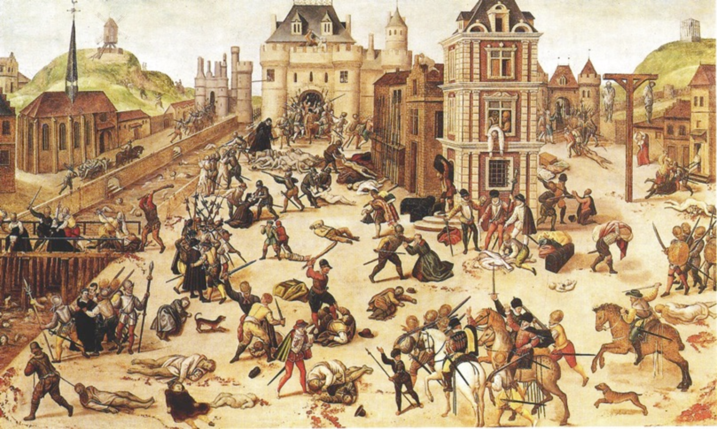
Strand Three: The History of Europe and the Wider World
Chapter Ten: The Reformation
Diagram taken from Artefact, 2nd Edition by Eimear Jenkinson and Gregg O'Neill (educate.ie)
@MsDoorley

Slide 45
Power of Kings
The Pope no longer had any control over countries that were now Protestant. In those countries, all Catholic Church properties were seized by the Crown, which made those rules much wealthier. It also removed a challenge to their power by giving them control over the religion of their countries. Even for Catholic countries, the Pope needed the support of the ruler to keep them Catholic, so the Church’s power was much reduced.
Strand Three: The History of Europe and the Wider World
Chapter Ten: The Reformation
@MsDoorley

Slide 46
Education
Education became very important to both sides. Protestants wanted everyone to read and understand the Bible – meaning everyone needed a basic education. Catholics believed that the only reason people followed the Reformers was because they didn’t understand their faith. This lead to many schools were set up to educate Catholics. This lead to an increase in education levels for all people of Europe, in the countries where their faith was practiced.
Strand Three: The History of Europe and the Wider World
Chapter Ten: The Reformation
@MsDoorley

Slide 47
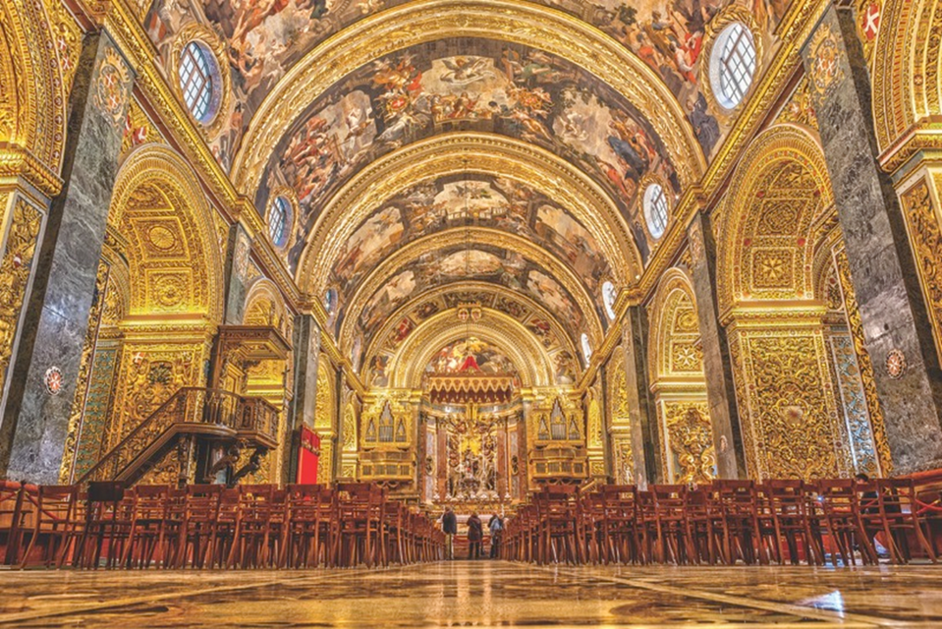
Art and Architecture
Protestants rejected the decoration of churches with statues and paintings because they saw them as sinful, wasteful and a distraction from the Bible. Their Churches became very simple and plain. Catholics, on the other hand, continued to spend lavishly on the decoration of their churches to celebrate their faith (and attract people to them). This led to the rise in the baroque movement in art.
Strand Three: The History of Europe and the Wider World
Chapter Ten: The Reformation
Diagram taken from Artefact, 2nd Edition by Eimear Jenkinson and Gregg O'Neill (educate.ie)
@MsDoorley

Slide 48
Checkpoint (pg. 112, Artefact, 2nd Edition)
  How did the Reformation lead to the persecution of people of different faiths?
  Name two countries that went to war with each other because of the Reformation?
  How did the Reformation lead to a reduction in the power of the Pope?
  What effect did the Reformation have on (a) education and (b) art?
Strand Three: The History of Europe and the Wider World
Chapter Ten: The Reformation
@MsDoorley

Slide 49
Checkpoint (pg. 112, Artefact, 2nd Edition)
1. Many countries had minority populations of either Catholics or Protestants. These groups were seen as a potential threat by their rulers and were persecuted to get them to change religions.
2. Any two of: England/Spain; Spain/Netherlands; various German states.
3. The Pope no longer had any control over Protestant countries, and in Catholic countries his power was reduced as he now needed the support of the local ruler.
4. (a) Both sides wanted to educate the people in their faith so that they would understand it better and therefore remain loyal. As a result, education greatly expanded in Europe; (b) The Catholic Church spent huge sums of money on its churches and filled them with art to make them more attractive than the plain Protestant ones. This started the Baroque movement in art.
Strand Three: The History of Europe and the Wider World
Chapter Ten: The Reformation
@MsDoorley

Slide 50
1517 to 1650
Chapter 10
8.6: SUMMARY
10.6: summary
Strand Three: The History of Europe and the Wider World
@MsDoorley

Slide 51
In this chapter, we have learned that...
The Reformation in Europe had a number of different causes:
  The Renaissance led people to question the Church’s authority.
  The incredible wealth of the Church caused resentment.
  Abuses such as nepotism, simony, absenteeism, pluralism and the sale of indulgences made many people question the Catholic Church.
  Kings wanted more control over the Church in their own countries.
  The problems came to a head when Martin Luther challenged the sale of indulgences, rejected the power of the Pope and attacked the abuses of the Church.
The Reformation spread across northern Europe from the 1520s onwards and had many important consequences:
  The Catholic Church launched the Counter-Reformation to try to stop the spread of Protestantism.
  The Inquisition tried and punished those accused of heresy.
  New religious orders (such as the Jesuits) were set up.
  The Council of Trent reformed the Church and rejected most of Luther’s ideas.
  The Reformation led to the division of Europe, religiously motivated violence and the decline in the power of the Pope.
Strand Three: The History of Europe and the Wider World
Chapter Ten: The Reformation
@MsDoorley

Slide 52
Reflecting on... the Renaissance
The Reformation shaped the history of Europe. Its challenge to authority can be seen as the beginning of the end for the absolute authority of kings. The religious divisions it unleashed can still be felt today. We only have to look at Northern Ireland: divisions between Catholics and Protestants have played a part in creating violence between the two communities. The Reformation is an excellent example of how one minor event – in this case, the protests of one German monk – can have a profound impact on the world.
Strand Three: The History of Europe and the Wider World
Chapter Ten: The Reformation
@MsDoorley

Slide 53
Examination Questions
2023 SEC Q2
Strand Three: The History of Europe and the Wider World
Chapter Ten: The Reformation
@MsDoorley

Slide 54
Project
Guidelines:
  Length: The depth of your project should reflect about 2-3 weeks of work.
  Sources: Use at least three different sources for your research. These can be books, scholarly articles, or reputable online resources.
  Citations: All information and images that are not your own should be properly cited.
  Mediums: You may choose to present your project in one of the following ways:
    Poster: Your poster should be informative and visually engaging.
    Minecraft or Lego Model: If choosing this option, please also include a brief report explaining your model.
    Painting/Drawing: Your artwork should be accompanied by a description.
    Recycled Materials: Create your model using recycled materials and provide an explanation of your creative process.
Assessment:
Your projects will be assessed based on:
  Research and Content
  Creativity and Presentation
  Understanding of Context
  Adherence to Guidelines
Strand Three: The History of Europe and the Wider World
Chapter Ten: The Reformation
@MsDoorley

Slide 55
Project
Historical Sites
Historical Figures
Castle Church, Wittenberg, Germany
St. Pierre Cathedral, Geneva, Switzerland
Hampton Court Palace Chapel, England
St. Peter's Basilica, Vatican City
St. Giles' Cathedral, Edinburgh, Scotland
Martin Luther
Pope Paul III
Pope Leo X
Elizabeth I
John Calvin
Henry VIII
Ignatius of Loyola
Ulrich Zwingli
Thomas Cromwell
Francis Xavier
Strand Three: The History of Europe and the Wider World
Chapter Ten: The Reformation
@MsDoorley

